Slide 1


TACTICAL COMBAT CASUALTY CARE COURSE
Module 12: Hypothermia Prevention and Treatment
MODULE 12: HYPOTHERMIA PREVENTION AND TREATMENT
TCCC TIER 1
All Service Members
TCCC TIER 2
Combat Lifesaver
TCCC TIER 3
Combat Medic/Corpsman
TCCC TIER 4
Combat Paramedic/Provider

Slide 2




Module 12: Hypothermia Prevention and Treatment
TACTICAL COMBAT CASUALTY CARE (TCCC) ROLE-BASED TRAINING SPECTRUM
ROLE 1 CARE
NONMEDICAL PERSONNEL
MEDICAL PERSONNEL
YOU ARE HERE
STANDARDIZED JOINT CURRICULUM
2

Slide 3






Module 12: Hypothermia Prevention and Treatment
1 x TERMINAL LEARNING OBJECTIVES
15
Given a combat or noncombat scenario, perform hypothermia prevention measures on a trauma casualty during Tactical Field Care and Tactical Evacuation Care in accordance with CoTCCC Guidelines.
  Identify the indications, progressive strategies, and limitations of active hypothermia prevention of a trauma casualty in Tactical Field Care
  Identify passive hypothermia prevention measures on a trauma casualty (CLS T12:E67).
  Demonstrate active and passive external warming hypothermia prevention and treatment measures on a trauma casualty.
03 x ENABLING LEARNING OBJECTIVES
#
= Terminal Learning Objectives
= Cognitive ELOs
= Performance ELOs
3

Slide 4
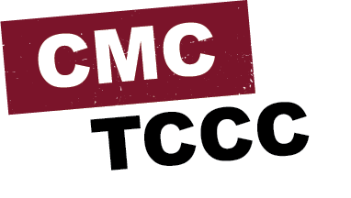

MARCH PAWS
Module 12: Hypothermia Prevention and Treatment
LIFE-THREATENING
AFTER LIFE-THREATENING
P A W S
_{M} MASSIVE BLEEDING
#1 Priority
_{A} AIRWAY
_{R} RESPIRATION (Breathing)
_{C} CIRCULATION
PAIN
ANTIBIOTICS
WOUNDS
SPLINTING
H
HYPOTHERMIA / HEAD INJURIES
4

Slide 5

HYPOTHERMIA PREVENTION
Video can be found on deployedmedicine.com
5

Slide 6




Module 12: Hypothermia Prevention and Treatment
HYPOTHERMIA
Hypothermia is a decrease in core body temperature This can result from exposure to cold air, water in the
environment, or casualty being placed on cold/damp ground
In trauma, hypothermia can result from impaired body thermoregulation due to bleeding and shock
Even a small decrease in core body temperature (below 36 degrees C or 96.8 degrees F) can increase mortality in trauma and burn casualties
The vicious cycle of acidosis, hypothermia and coagulation (lethal triad), requires prevention management strategies at each level
IMPORTANT CONSIDERATIONS:
Hypothermia is a potential concern in trauma even when operating in warm environments
M A R C
H

Slide 7
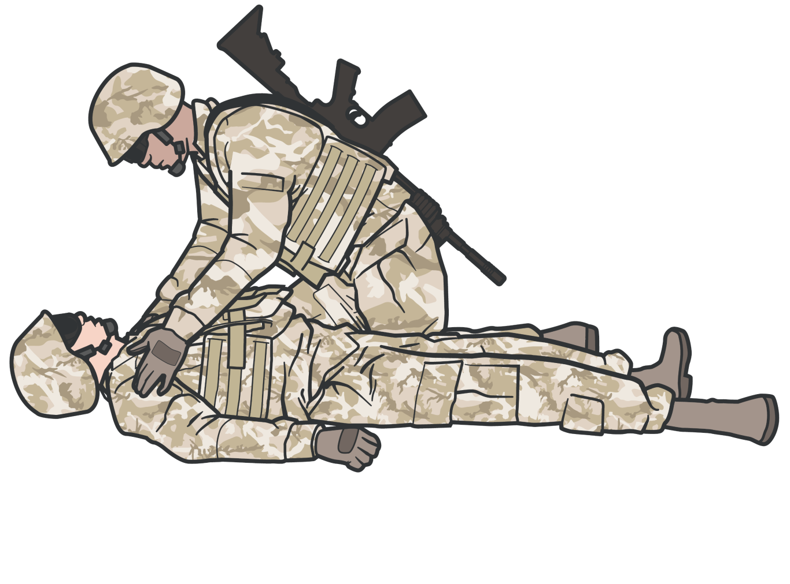
Module 12: Hypothermia Prevention and Treatment
HYPOTHERMIA SIGNS AND SYMPTOMS
Maintain a high index of suspicion when operating in cold, wet, windy environment
SHIVERING in mild hypothermia
CONFUSION, DISORIENTATION, SLURRED SPEECH
BREATHING SLOWS with DECREASED
RESPIRATORY DRIVE in moderate to severe hypothermia
ALL trauma casualties in shock or at risk of shock are at risk for trauma-induced hypothermia even when operating in warm environment
M A R C
H

Slide 8
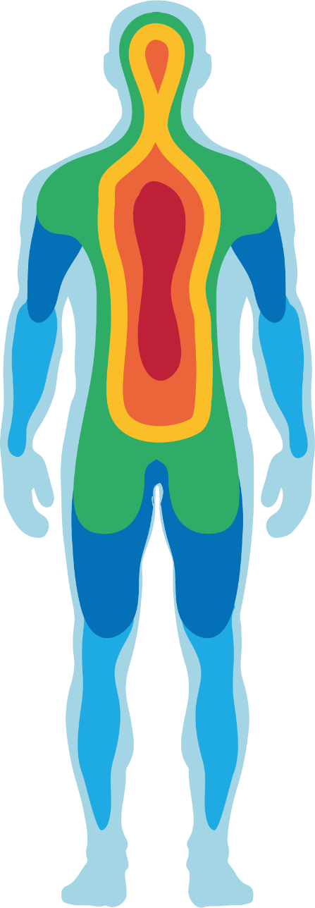
TRAUMA’S LETHAL TRIAD
Module 12: Hypothermia Prevention and Treatment
Environmental factors
Physiologic response
to BLOOD LOSS
Clotting factor dysfunction from hypothermia
Casualties with BURNS are also at increased risk of hypothermia
HYPOTHERMIA
COAGULOPATHY
ACIDOSIS
M A R C
H

Slide 9
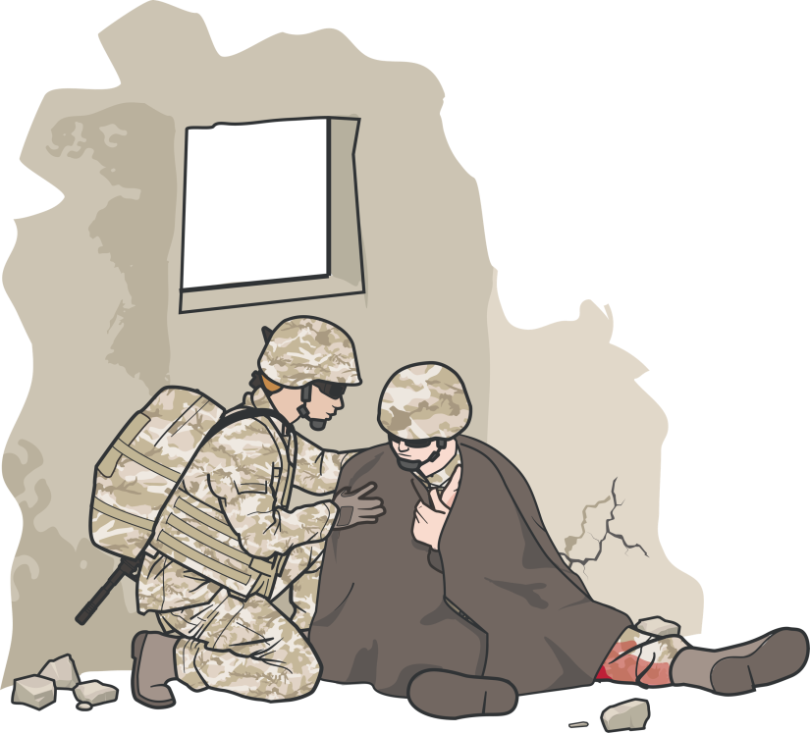
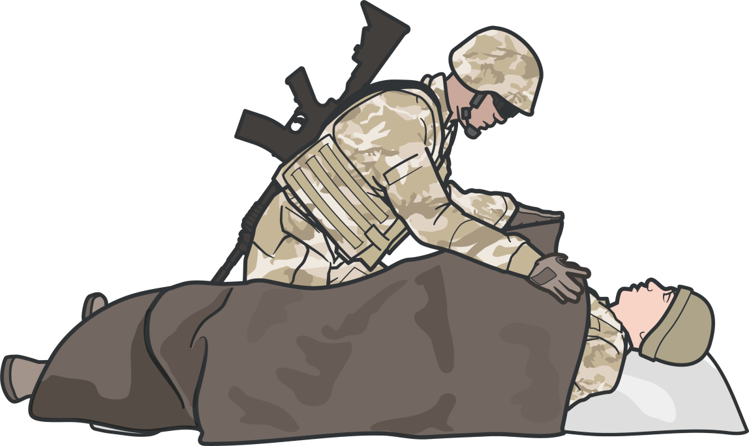
Module 12: Hypothermia Prevention and Treatment
ACTIVE HYPOTHERMIA PROGRESSIVE STRATEGIES
Take early/aggressive steps to prevent further body heat loss
Add external heat when possible, for both trauma and severely burned casualties
Minimize the casualty’s exposure to the elements
Replace wet clothing with dry, if possible
It is much easier to prevent hypothermia than to treat it
M A R C
H

Slide 10
Module 12: Hypothermia Prevention and Treatment
HYPOTHERMIA INDICATIONS
Moderate to severe trauma Central nervous system trauma
Burn patients >33% TBSA with second - or third- degree burns
Altered level of consciousness/unresponsive Inability to shiver
Hypothermic patients with core temperature
<28°C (82.4°F)
ALL trauma casualties in shock or at risk of shock are at risk for trauma-induced hypothermia even when operating in warm environment
M A R C
H

Slide 11
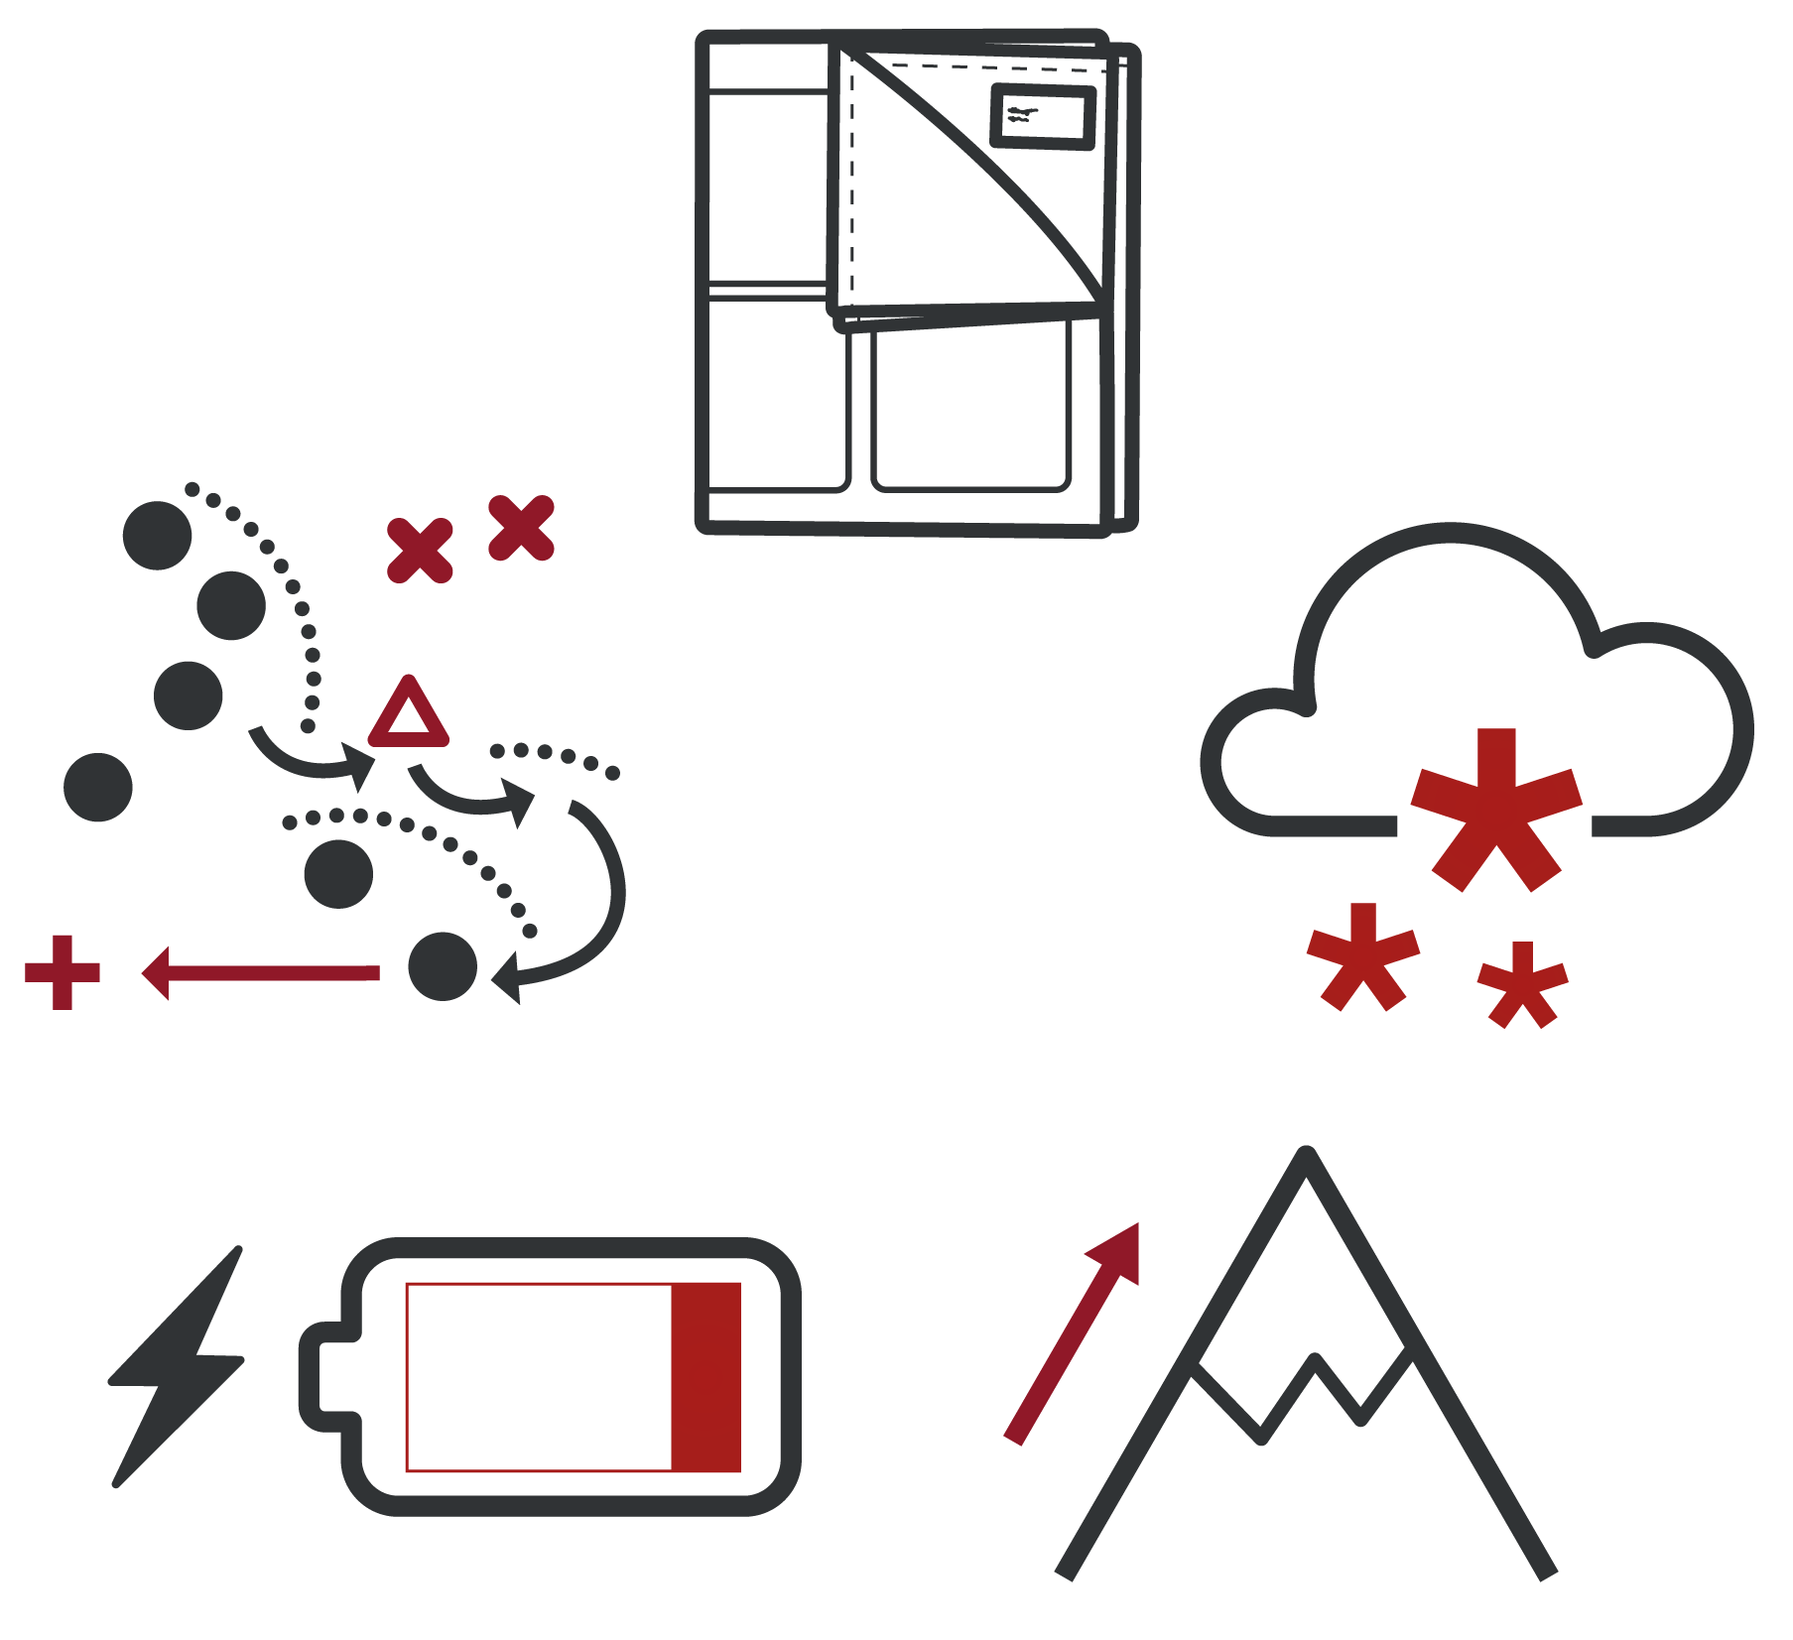
Module 12: Hypothermia Prevention and Treatment
ACTIVE HYPOTHERMIA LIMITATIONS
Possible active hypothermia limitations may include:
Service specific mission and load out Limitation of active rewarming devices Cold Weather
Altitude (if oxygen/chemical driven)
Loss of power to battery powered IV fluid warming device(s)
M A R C
H

Slide 12
HYPOTHERMIA PREVENTION
Module 12: Hypothermia Prevention and Treatment
Prevent additional body heat loss
Minimize the casualty’s exposure to the elements
Keep protective gear and dry clothing on/with the casualty if feasible
Place active heating blanket on casualty’s anterior, torso, head, and axillae
Enclose the casualty in the exterior impermeable enclosure bag
Upgrade hypothermia enclosure system to a well insulated enclosure system
It is much easier to prevent
hypothermia than to treat it
M A R C H
12

Slide 13
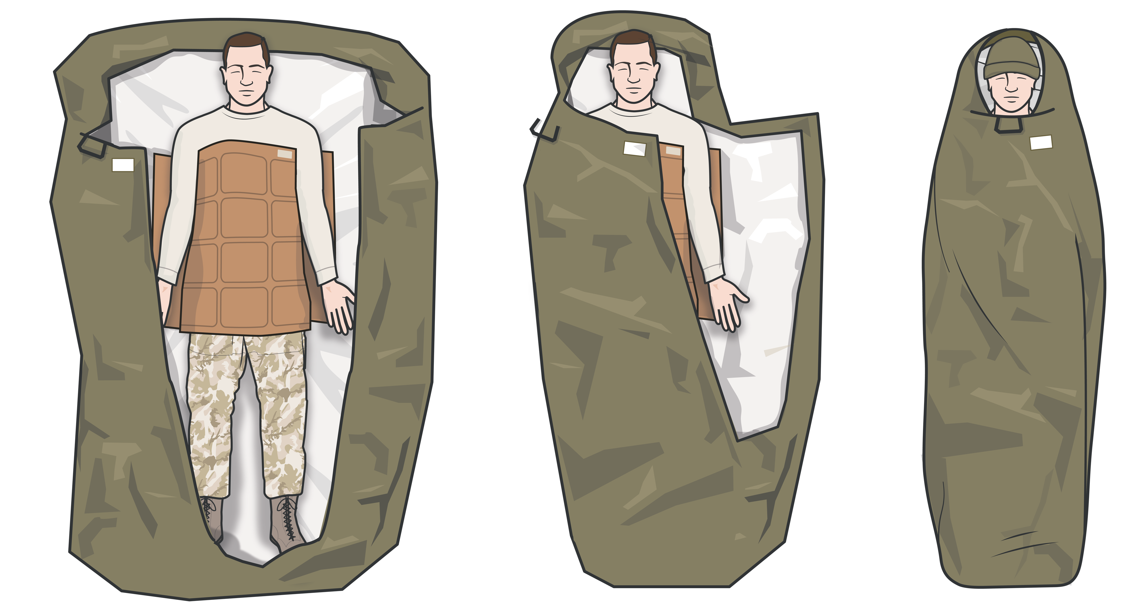
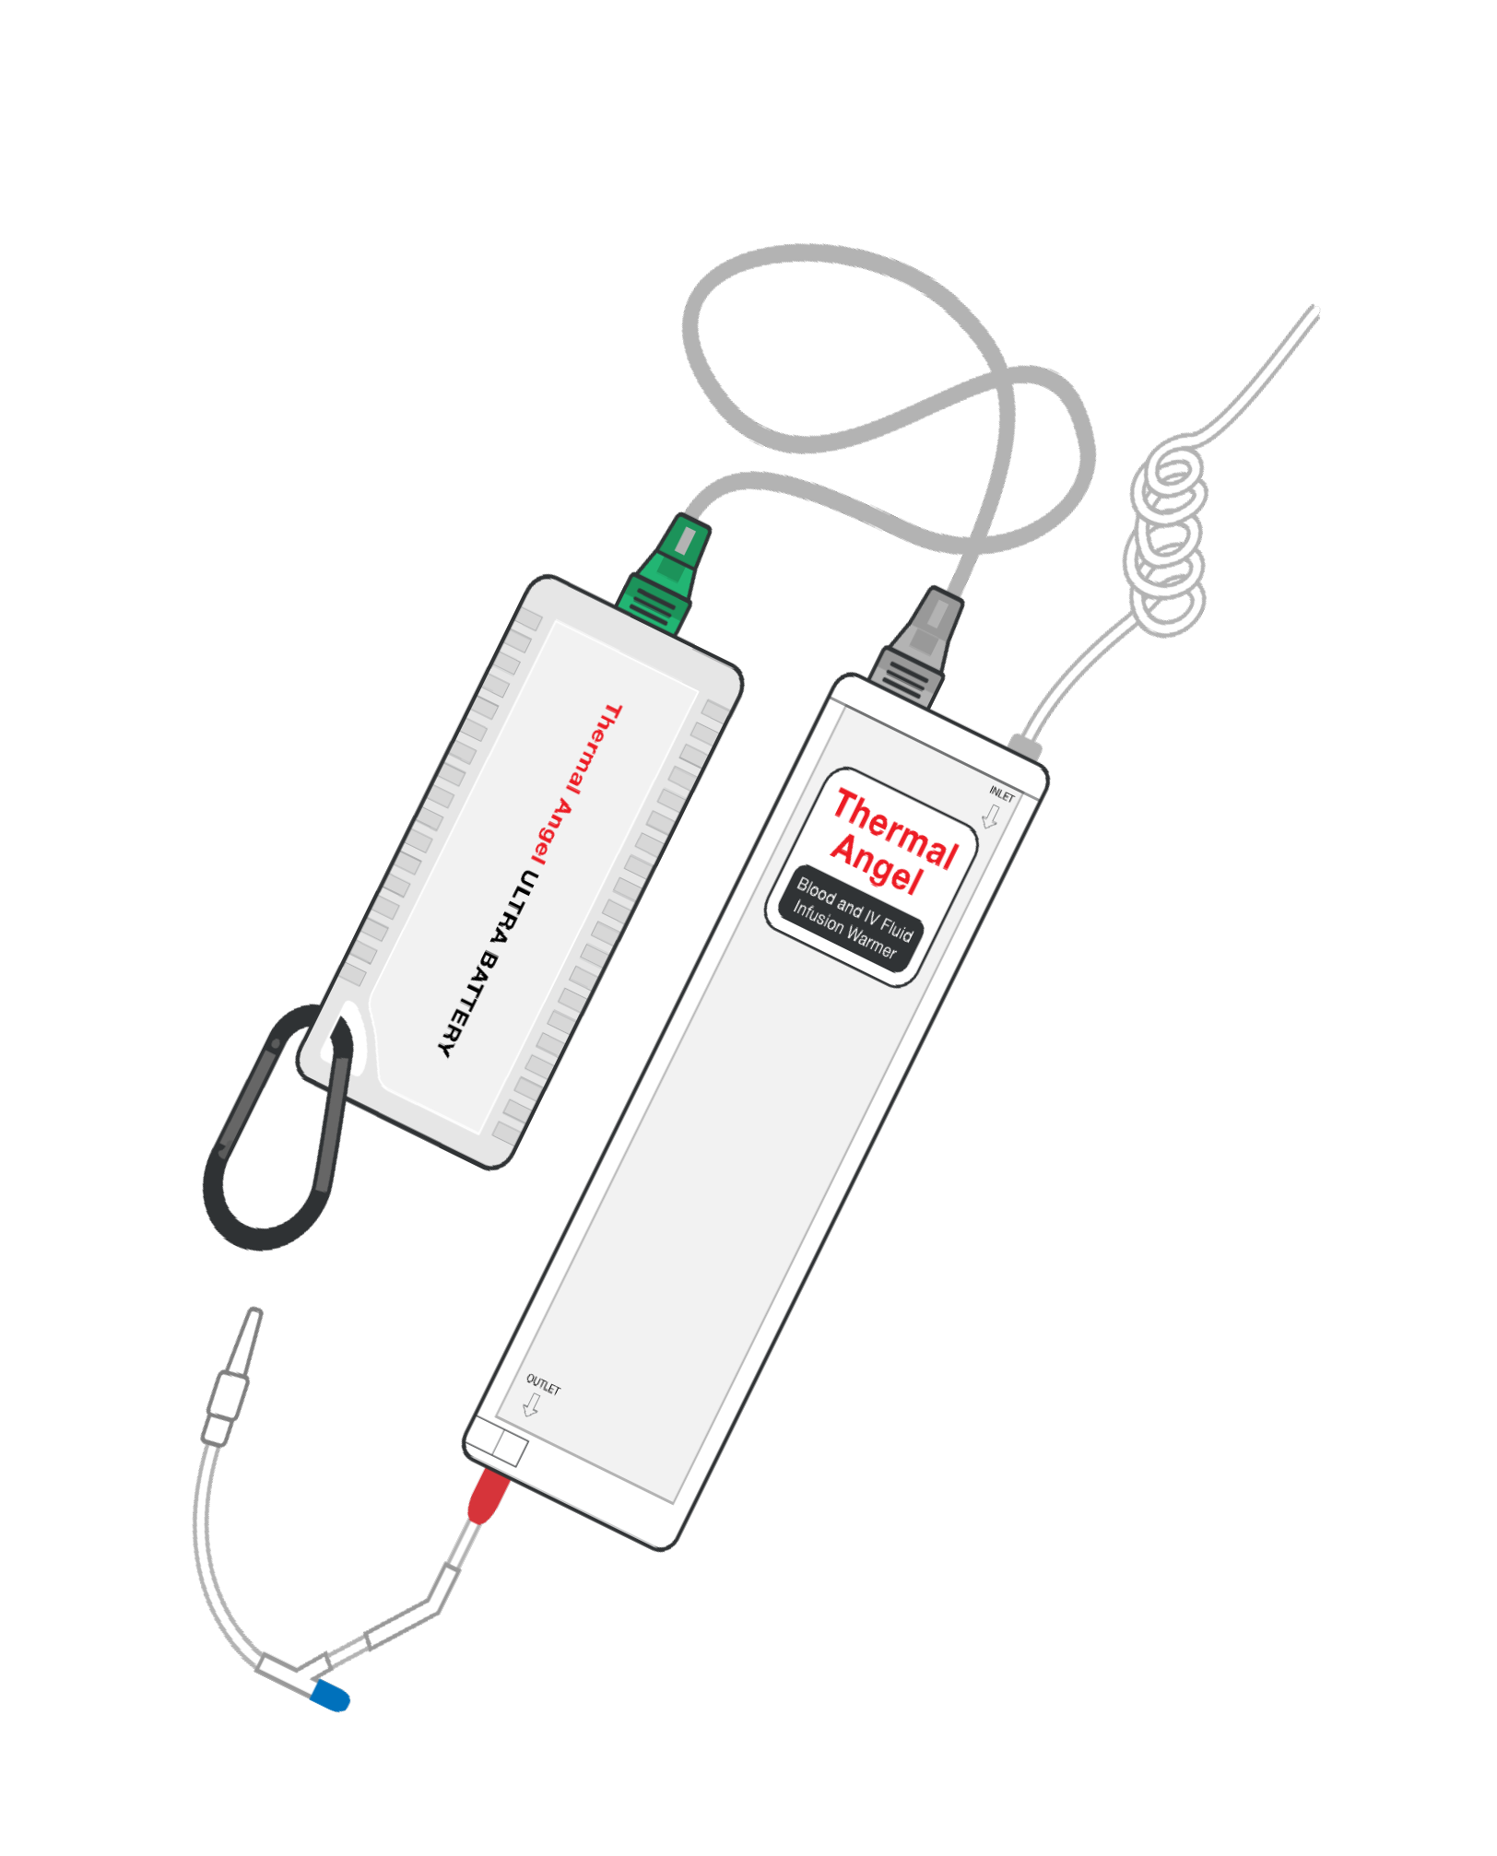
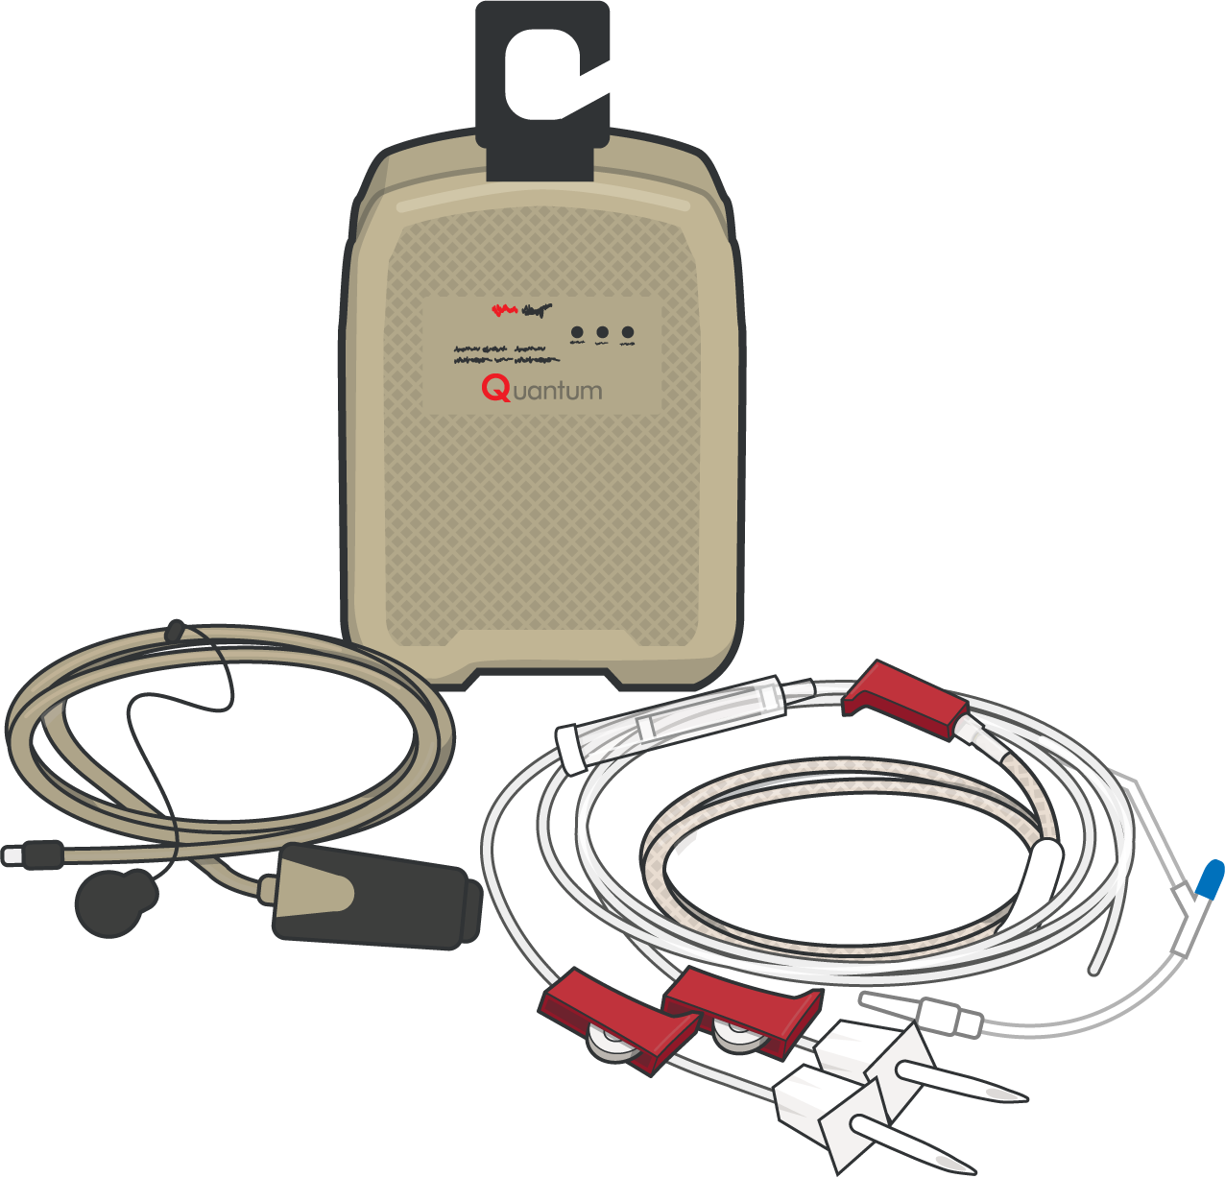
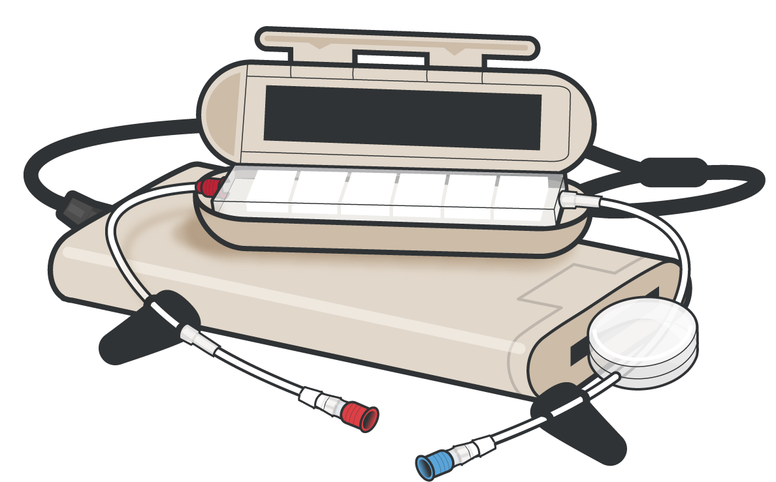
Module 12: Hypothermia Prevention and Treatment
ACTIVE HYPOTHERMIA MANAGEMENT
In addition to aggressive steps taken early to prevent further loss of body heat, when possible, trauma and severely burned casualties should be actively warmed
ACTIVE hypothermia treatment uses external heating sources to warm the casualty
If commercial hypothermia kit is not available, improvised vapor barrier can be utilized
As a mission planning factor, an insulated hypothermia enclosure system with external active heating should be pre-staged
CAUTION: Do not apply active warming blanket directly to bare skin to prevent burns
Use battery powered IV warming devices:
Flow rate up to 150 ml/min 38°C output temperature
M A R C
H

Slide 14
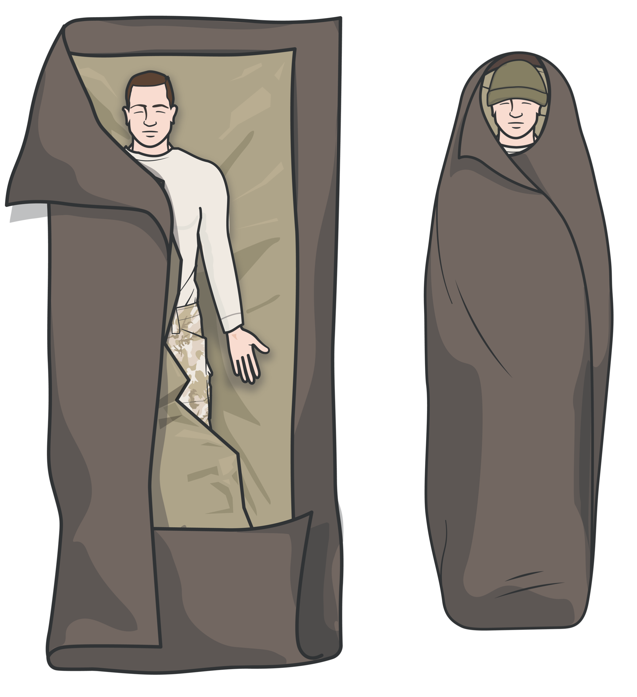
Module 12: Hypothermia Prevention and Treatment
PASSIVE HYPOTHERMIA MANAGEMENT
Passive hypothermia management does not reverse the hypothermic process, due to significant blood loss
If an active warming device is not available, wrap passive warming materials under and around the casualty
Enclose casualty in vapor barrier to retain heat and keep dry/insulated
Upgrade as additional materials become available
KEY POINTS
Blood loss can cause a significant drop in body temperature, even in hot weather
Wrap the entire blanket-like shell (or passive heating materials) completely around the casualty, including the head
Do not cover the face
Keep the casualty off the ground
M A R C
H

Slide 15

SKILL STATION
Module 12: Hypothermia Prevention and Treatment
Hypothermia (skill)
Active / passive hypothermia prevention and management

Slide 16
SUMMARY
Module 12: Hypothermia Prevention and Treatment
Hypothermia is decreased core body temperature secondary to external environmental factors and/or hemorrhage and shock
Hypothermia in trauma patients is an independent predictor of mortality
Hypothermia is a consideration even in hot operational environments as hemorrhage and shock can cause significant hypothermia in trauma casualty
Active hypothermia management/prevention is preferred, when available, and involves external heating of the casualty
Passive hypothermia management/prevention can be used when active warming is not available. It DOES NOT reverse the hypothermic process
Hypothermia is easier to prevent than it is to treat
M A R C H

Slide 17

CHECK ON LEARNING
Module 12: Hypothermia Prevention and Treatment
Why is it important to prevent/manage hypothermia in a trauma casualty?
True or False? Hypothermia is not an issue in hot operational environments?
What is the difference between active and passive hypothermia management?

Slide 18



Module 12: Hypothermia Prevention and Treatment
ANY QUESTIONS?

Slide 19

REFERENCES
Module 12: Hypothermia Prevention and Treatment
TCCC: Guidelines
by JTS/CoTCCC
Updated regularly – latest edition dated 5 November 2020
These guidelines are the result of decisions made by the Committee on Tactical Combat Casualty Care as they explore evidence-based research regarding best practices
PHTLS: Military Edition
by NAEMT
Prehospital Trauma Life Support, Military Ninth Edition
NOV 2020

